Slide 1






Lesson 3.1: Introduction to Probability
Conditional Probability Bayes' Theorem
Presenters: Janen B. Merto, Fergielyn Capa, Erica B. Cajayon

Slide 2





Topics
01
Conditional Probability
02
Bayes' Theorem

Slide 3




Conditional Probability
For any two events A and B with P(B) > 0, the conditional probability of A given that B has occurred.
Usually recognized in a word problem by words like given, if, among, or suggested.
𝑃(𝐴∩𝐵)
𝑃(𝑨|𝑩) =
————————
𝑃(𝐵)

Slide 4
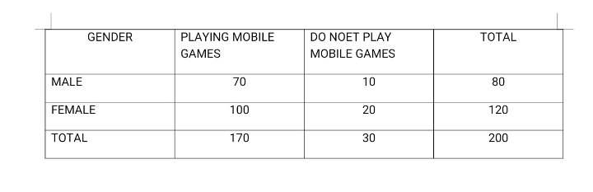
Example
If a student is randomly chosen, what is the probability that student is:
B. a male who plays mobiles games?
C. a male given that he is playing mobile games?
D. a female given that she is playing mobile games?

Slide 5

Example

Slide 6

Example

Slide 7

Example

Slide 8




Bayes' Theorem
A common solution for some mistakes regarding conditional probabilities or
incorporate information about subsequent events.
It is a pillar of both probability and statistics.
Developed by Thomas Bayes (1701 – 1761)

Slide 9
Bayes' Theorem
𝑃(𝐴∩𝐵)
𝑃(𝑨|𝑩) =
————————
𝑃(𝐵)
𝑃(𝑩|𝑨) 𝑃(𝐴)
𝑃(𝑨|𝑩)
=
———————————————————
[𝑃(𝐴) . 𝑃(𝐵|𝐴)] + [𝑃(𝐴) . 𝑃(𝐵|𝐴)]
𝑺𝑼𝑩𝑺𝑬𝑸𝑼𝑬𝑵𝑻 𝑬𝑽𝑬𝑵𝑻𝑺
𝑃(𝑩|𝑨) 𝑃(𝐴)
𝑃(𝑨|𝑩)
=
————————
𝑃(𝐵)

Slide 10
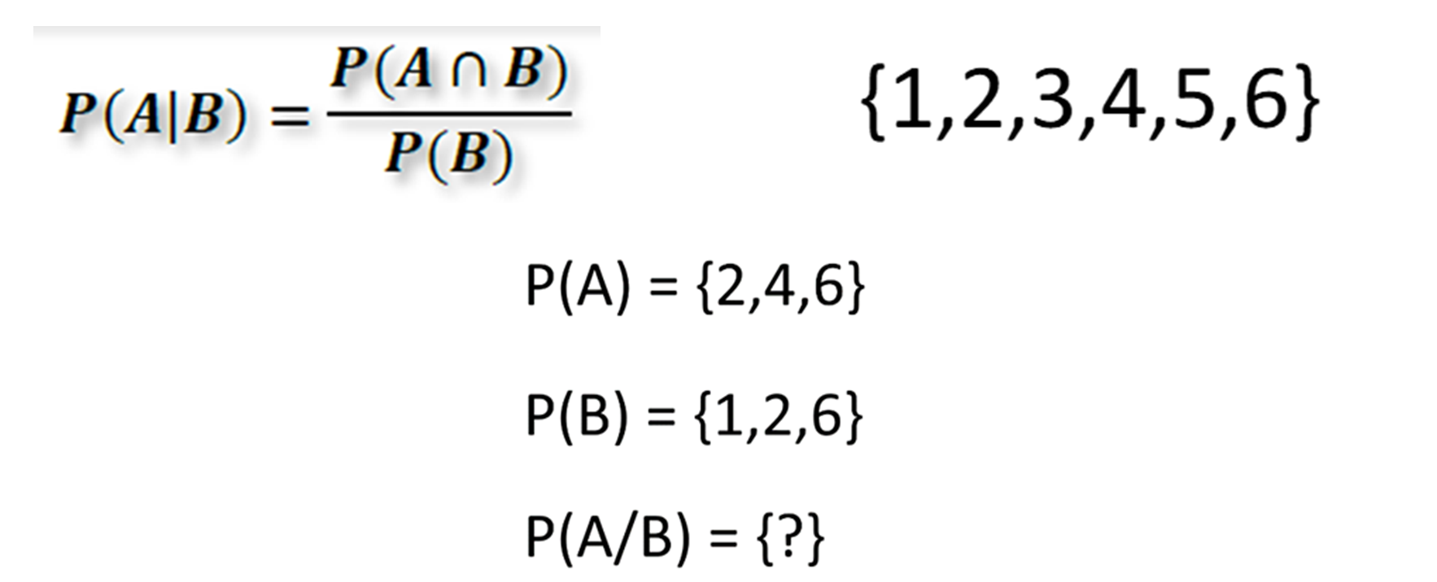
Example

Slide 11
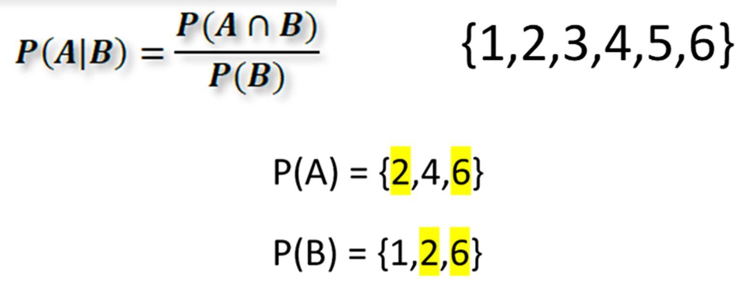
Example

Slide 12
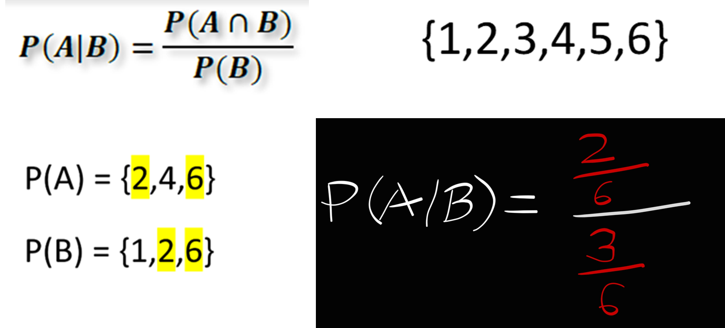
Example

Slide 13
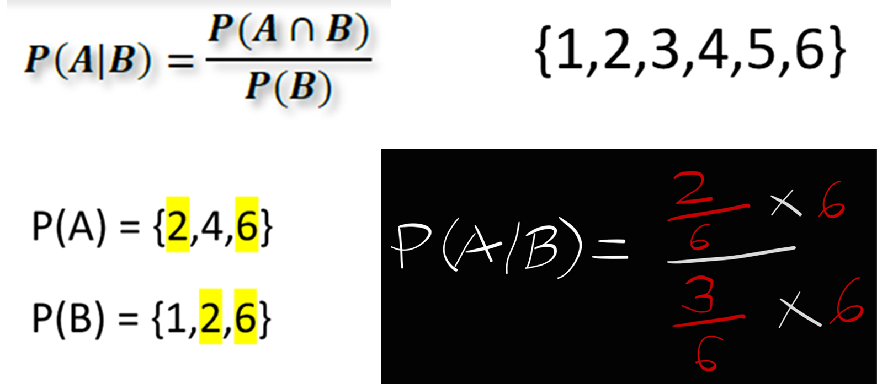
Example

Slide 14
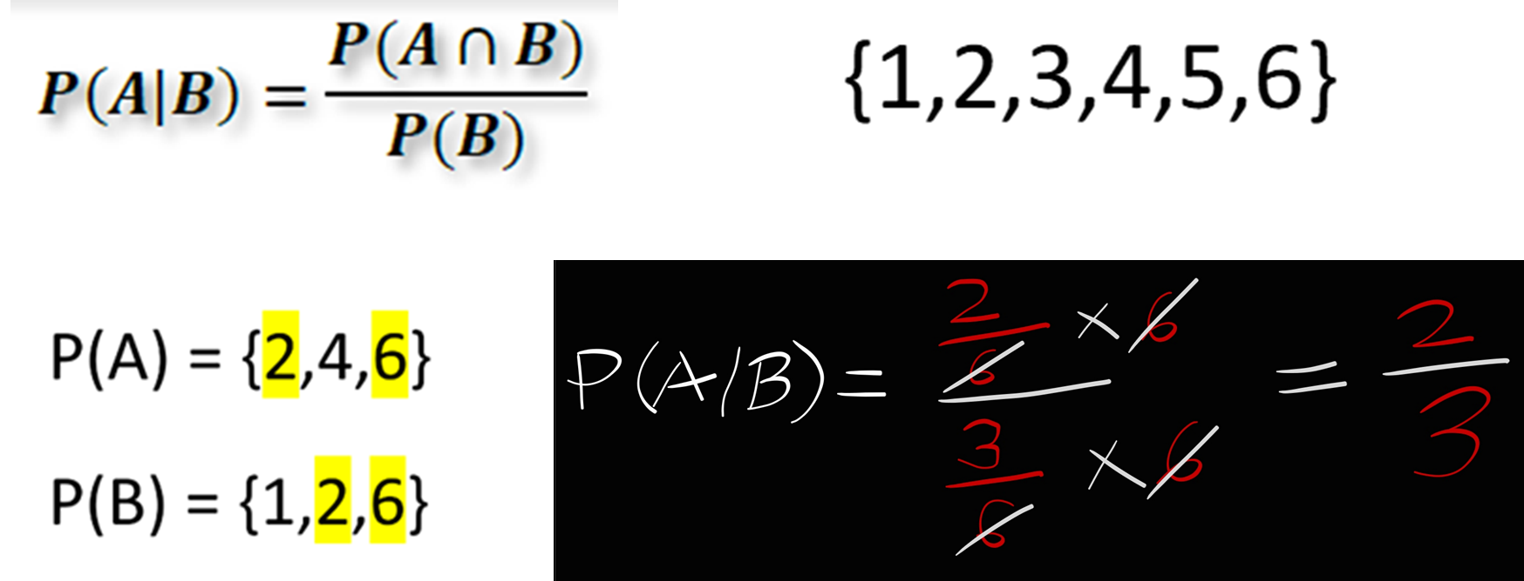
Example

Slide 15
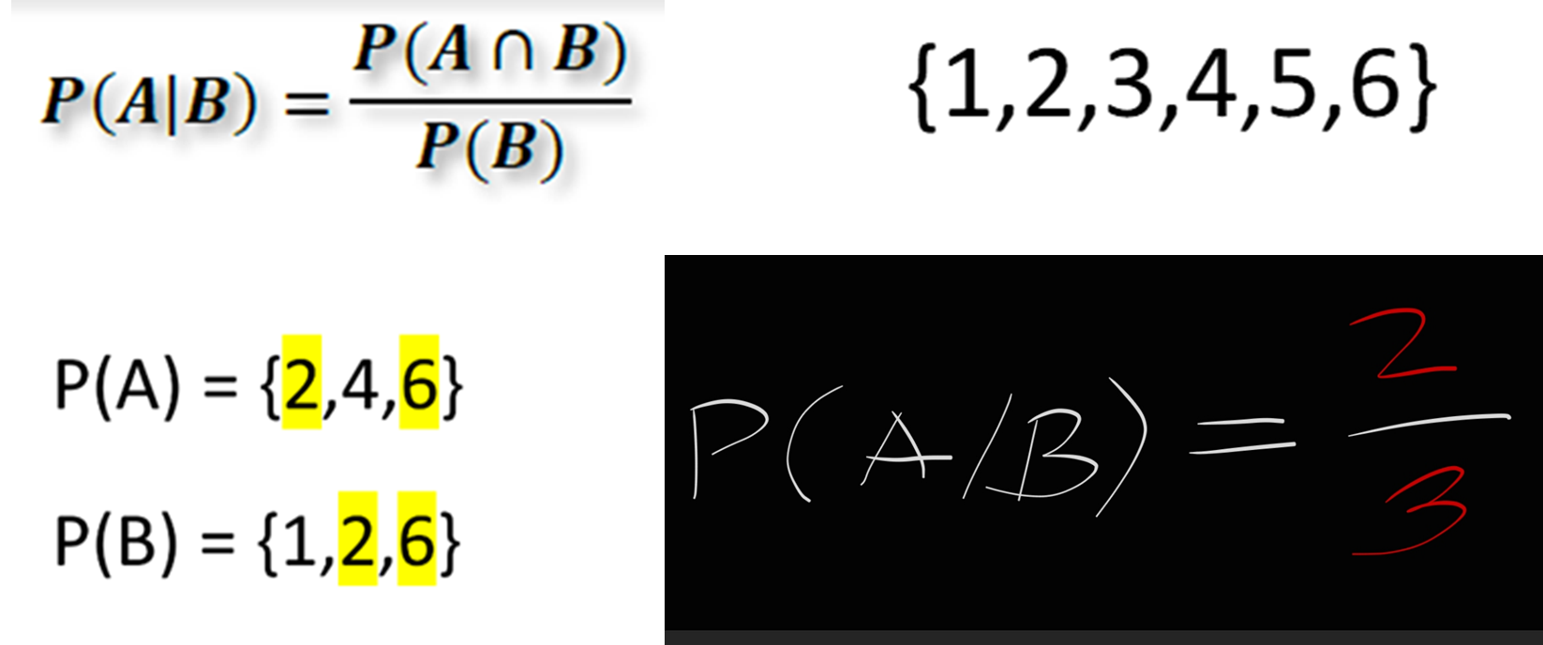
Example

Slide 16
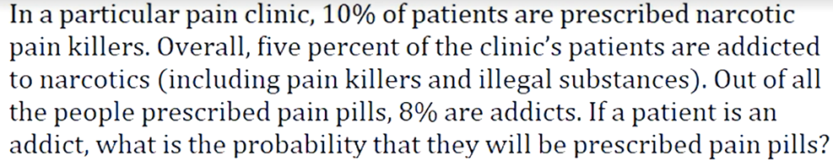
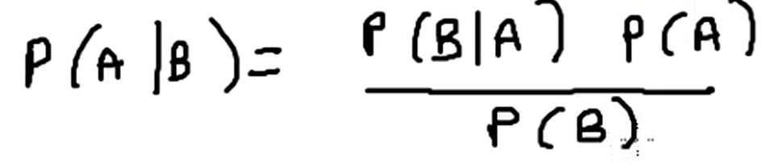
Example
A: Being Prescribed pain pills. 10%
B: Being an addict 5%
B/A: Prescribed pain pills – addict prob. 8%

Slide 17
Example
A: Being Prescribed pain pills. 10%
B: Being an addict 5%
B/A: Prescribed pain pills – addict prob. 8%
P(A/B) =
(0.08 * 0.1)
/ 0.05
= 0.16 OR 16%

Slide 18


Thank you

